Slide 1
Voting Dapp
Voting application using Blockchain technology
Client: Hoang Le Minh
Team Member: Pham Huynh Tri Minh – Nguyen Trong Tri
Mentor: Vo Dong Thanh Tin
Notes:
Perfect time to present because only 2 months remain to work on the project
In order to finalize the scope and complete the product
Give a first look of the application of what it is capable of

Slide 2
Agenda
Project objectives
Application features
Working environment
Demo
Achievements
Challenges remained
Next steps

Slide 3
Project: Voting using Blockchain technology
Scope of the project:
Internal Bosch, at least 10 computers work in the network.
Challenges:
Voting:
Regulate 1 person – 1 account.
Verifying the eligible account in order to join to the polling.
Display the events of the voting.
Technical:
Technical explanation.
Read the data from blockchain.
Be able to manage voters and voting events.

Slide 4
Project: Voting using Blockchain technology
Solution to Voting issues:
Anonymity: blockchain technology
1 associate - 1 account: Use BOSCH ID
Only permitted voters are able to vote
1 account - 1 vote: restrict the casting ballot feature of voted account.
Count legitimate vote only
Notes:
create a list of ID that is allowed to cast vote and only these IDs is able to cast vote and observe result
Create account means create an address in blockchain. Only accounts created by the application are able to execute the function.
An account that has already casted a vote is not able to cast another vote. However they can edit their ballot before the room closed.
only validated account that can vote and they can vote once that make the result more reliable.
The result is able to display the ballots of the voters, their existents and proofs of those ballots without revealing the voter identities thanks to blockchain technology.

Slide 5
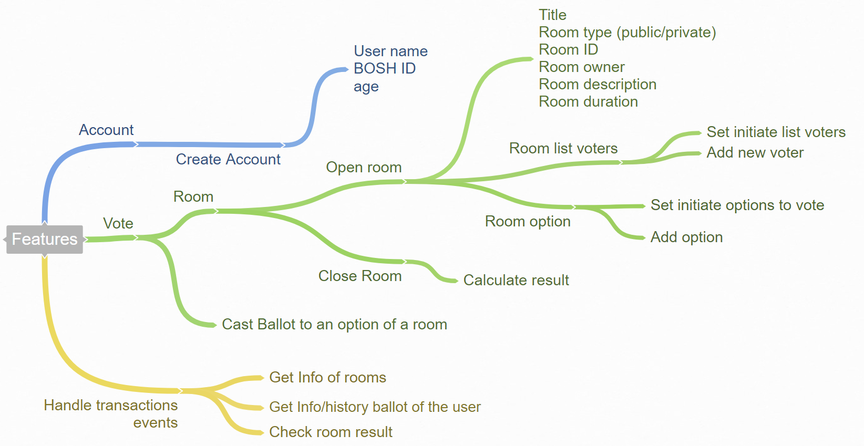
Project: Voting using Blockchain technology
Notes:
Create account means create an address in blockchain. Only accounts created by the application are able to execute the function.
An account that has already casted a vote is not able to cast another vote. However they can edit their ballot before the room closed.

Slide 6
Project: Voting using Blockchain technology
Create account: using BOSCH ID
Create a vote room: description and duration
Option: set initiate option / add option
List voter: set initiate list of voters / add voter
Room duration
Close the room: halt the voting feature
Join the vote
Cast ballot
Get ballot
Check result

Slide 7
Technology
Blockchain technology
Trust
Transparency
Anonymity
Robustness
Integrity
Trade-off:
Performance
Confidentiality
Cost money
Notes:
Confidentiality: everyone on the network would somehow realize the existence of the voting event.
Due to running on the private network, there is no need to consider the amount of gas consumed. In fact gas on private network only uses for program execution regulation.

Slide 8



Working Environment
Platform: Ethereum
Developing framework: Truffle
Development framework
for Ethereum
Front-end: Angular
Back-end: smart contract
Written in Solidity programming language
Interact between front-end and back-end:
web3.js JavaScript library

Slide 9
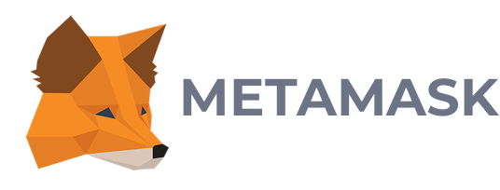
Working Environment
Network: Private Ethereum network
geth (go ethereum): CLI written in Go language that allow interacting with Ethereum network
*MetaMask:
A bridge to connect to Ethereum network

Slide 10
Demo

Slide 11
Achievement
Blockchain technology – Ethereum
Angular
Smart contract
Write a contract in solidity language
Interact with smart contract
Learn how the smart contract works
Learn the progress of handling transactions of blockchain technology (Ethereum)
Create a private Ethereum network
Make voting application work on Ethereum platform

Slide 12
Challenges remained
Technical
New stuffs – new bugs to catch – new knowledge to obtain
Very few reference documents and tutorials. Most of them are posted recently (from Sep, 2017).
Application:
Programming logic is not good -> consume more GAS than it should be
Security and audit are not that good
Some shortage features and checksum functions

Slide 13
Challenges remained
Non-technical
Lacking of handling documents skills
Tasks are not well-organized
Incompetent of dealing with business reasons
Notes:
This is our first official project so we are lack of management skills such as documents and tasks.
Display or not the list of voter to who is in the vote

Slide 14
Next steps
Finalize the product
Improve the consistency of smart contract
Enhance the security of the application
Update additional features
Vote multiple options
Allow voters in the room to add their option
Create an election
Learn how to write genesis block to improve the efficiency of the network

Slide 15
Thanks for listening
Q/A

Slide 16
GAS
What if there is an infinity loop that crash the program within the blockchain?
In the main Ethereum network, the program execution cost money
Gas is used to regulate the program execution in Ethereum blockchain

Slide 17
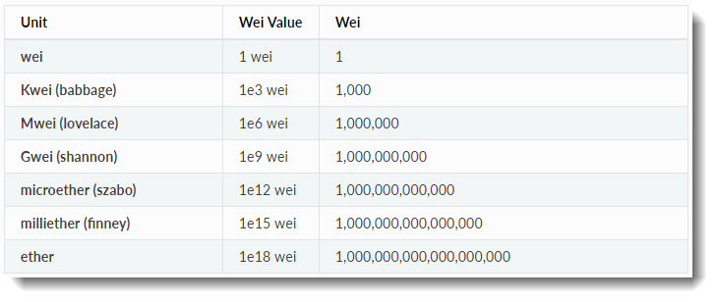
GAS
What if there is an infinity loop that crash the program within the blockchain?
\

Slide 18
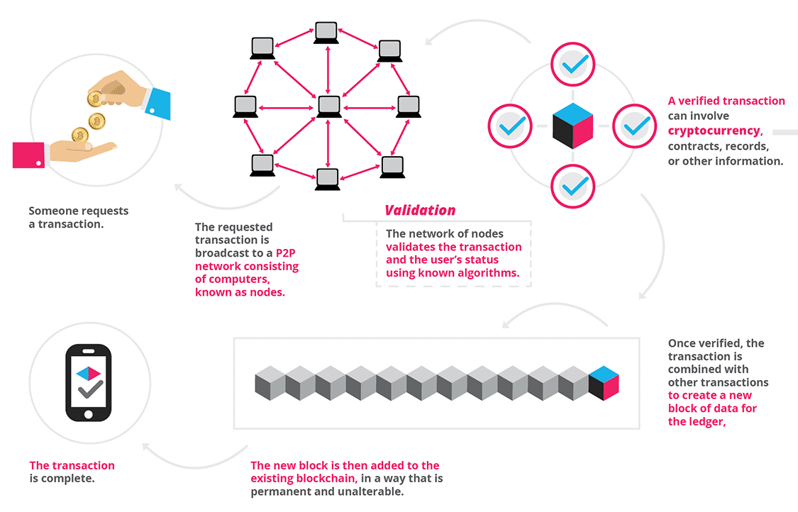
Notes:
Summary

Slide 19

Decentralized Application (Dapp)
Browser
Smart Contract
http://localhost:4200
Search
compiler
index.html
Ethereum
Network
JSON interface
ABI
bytecode
style.css
Contract
address
NODE
EVM
app.js
Read contract
Web3.js
JSON-RPC
NODE
Notes:
An application has a html file a css file and a js file
Js file simply take control of the application.
It can talk to a node in the ETH network using web3 library
Web3.js provides JavaScript APIs to communicate with any kind of Ethereum that supports JSON-RPC. It use JSON-RPC internally to make the communication. It exposes all JSON-RPC APIs as JavaScript APIs

